Slide 1
Design equations and model parameters of components
By Stig Munk-Nielsen

Slide 2
Agenda (not necceary cronological)
Design equations for Shunt TL431 controller (link between circuit component values and transfer function)
Design procedure (recipe)
Models of components (+ Szymon )
Measuring/determining model parameters
Example: layout of dc-dc boost converter
Exercise: Measurement of model parameters.

Slide 3
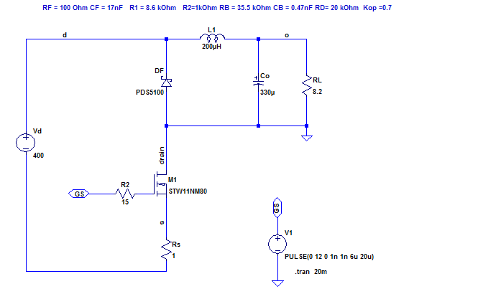
Buck Converter

Slide 4
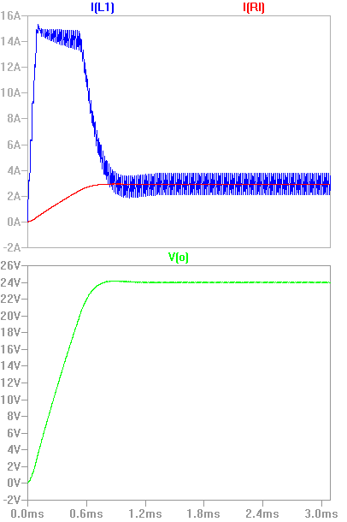
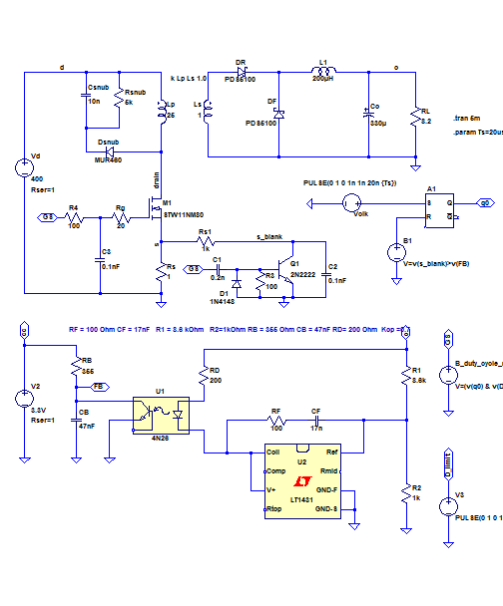
Forward Converter (Buck with transformer)
Type II controller

Slide 5
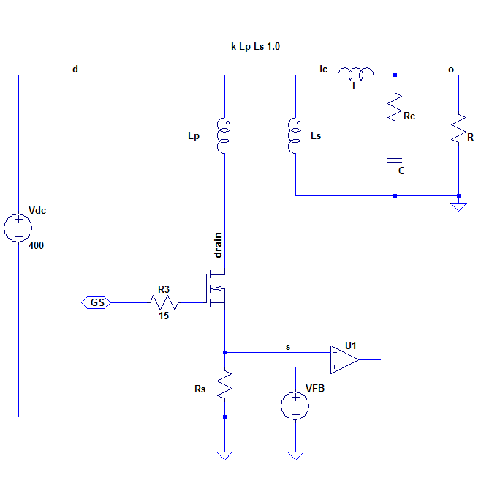



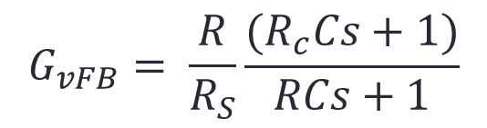

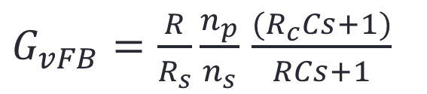


Buck: Control-to-output function including ESR in capacitor (Rc)
$${\hat{i}}_{c}$$
$${\hat{v}}_{FB}$$
$$G_{vFB}=\frac{{\hat{v}}_{o}}{{\hat{v}}_{FB}}$$
$${\hat{v}}_{o}$$
$${\hat{v}}_{o}$$
$$G_{vFB}= \frac{R}{R_{S}}\frac{(R_{c}Cs+1)}{RCs+1}$$
Buck:
$${\hat{v}}_{FB}$$
$G_{vFB}=\frac{R}{R_{s}}\frac{n_{p}}{n_{s}}$ $\frac{(R_{c}Cs+1)}{RCs+1}$
Forward:

Slide 6
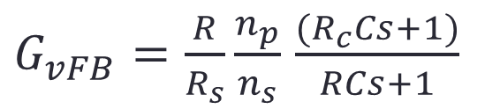

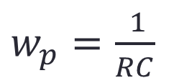

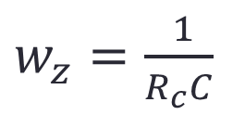


Block function
$G_{vFB}=\frac{R}{R_{s}}\frac{n_{p}}{n_{s}}$ $\frac{(R_{c}Cs+1)}{RCs+1}$
$$G_{vFB}$$
$$v_{FB}$$
$$\frac{R}{R_{s}}\frac{n_{p}}{n_{s}}\frac{\left(\frac{s}{wz}+1\right) }{(\frac{s}{wp}+1)}$$
$$v_{o}$$
$w_{z}=$ $\frac{ 1}{R_{c}C}$
$w_{p}=$ $\frac{ 1}{RC}$
Notice: R_{C} is a parasitic element of the capacitor !

Slide 7
So now we need the Controller : -)

Slide 8
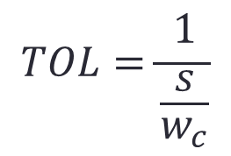






What kind of behavior do we want from our Power Stage + Controller ?
DC gain -> very high
$$w_{c}$$
$$TOL=\frac{1}{\frac{s}{w_{c}}}$$
Open Loop
TOL:
$$f \left[Hz\right]$$
$$f_{c}$$
$$w_{c}$$
Close Loop
CL:
$$f \left[Hz\right]$$
$$f_{c}$$

Slide 9
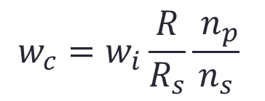








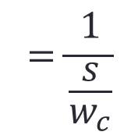
Block diagram: Current Programmed Control
$$G_{compensator}$$
$$G_{vFB}$$
$$v_{ref}$$
$$v_{FB}$$
$$v_{o}$$
$$\frac{ (\frac{s}{wzc}+1)}{\frac{s}{wi}(\frac{s}{wpc}+1) }$$
$$\frac{R}{R_{s}}\frac{n_{p}}{n_{s}}\frac{\left(\frac{s}{wz}+1\right) }{(\frac{s}{wp}+1)}$$
$$\frac{ 1}{\frac{s}{wi} }\frac{R}{R_{s}}\frac{n_{p}}{n_{s}}$$
$$w_{c}=w_{i}\frac{R}{R_{s}}\frac{{ n}_{p}}{n_{s}}$$
$$=\frac{1}{\frac{s}{w_{c}}}$$
TOL:
Notice :
TOL:
Assuming: w_{z}=w_{pc} and w_{zc} = w_{p}

Slide 10
Design with TL431

Slide 11
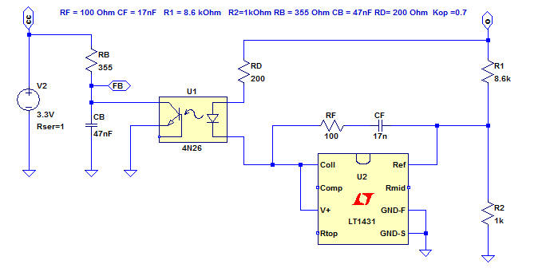
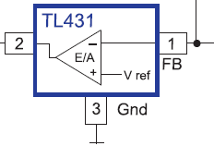
Shunt controller: TL431
Type II controller

Slide 12
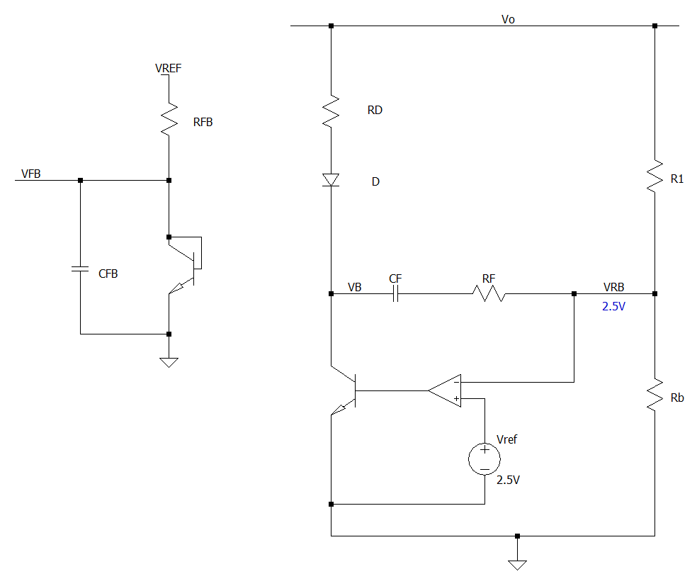
Controller circuit
i_{D}
i_{RFB}
+
-
+
-
i_{R1}
V_{RD}
+
-
+
-
V_{D}
V_{R1}
i_{CFB}
i_{C}
light
+
-
- +
i_{F}
TL 431
i_{RB}
+
-
V_{RB}

Slide 13
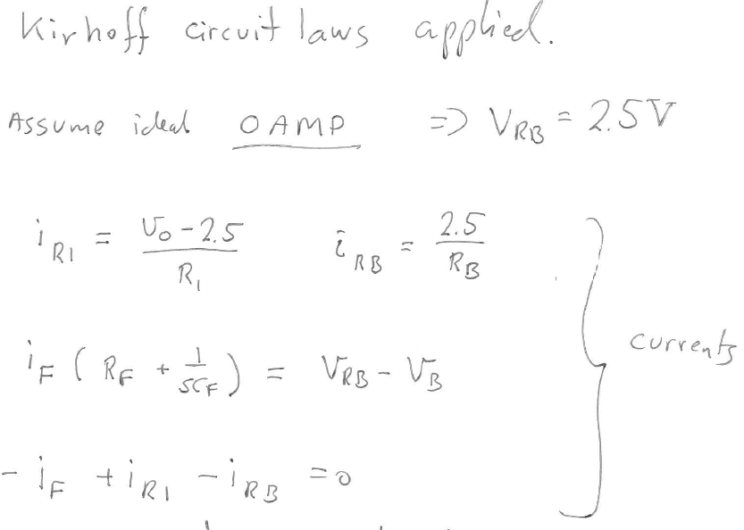

Slide 14
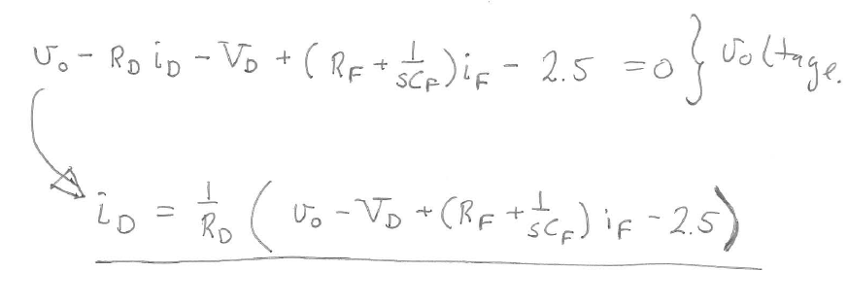
Voltage equation:

Slide 15
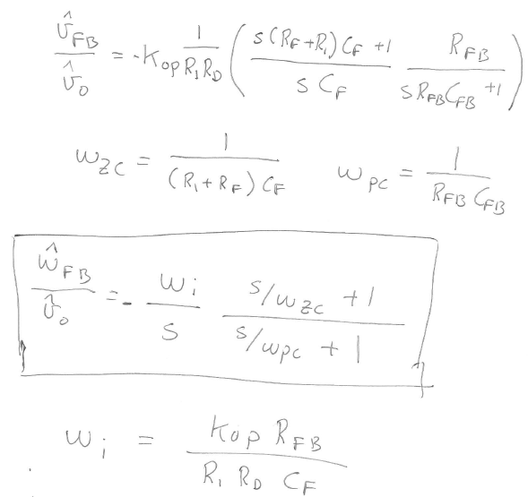
After long mathematical organizing – se MOODLE: PDF document: TL431_component_values_and_transfer_function

Slide 16
Example: layout of dc-dc boost converter
Presentation of components
Inductor
Current and voltage measurement equipment
LCR meter
Componenents
Rapid prototyping of power elctronics
Current programmed Boost converter

Slide 17
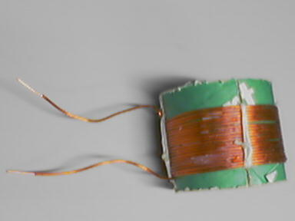
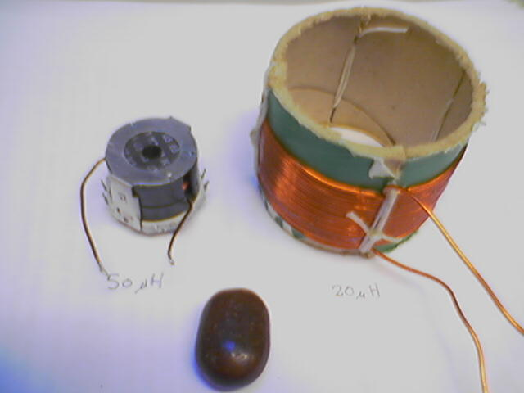
Inductor

Slide 18
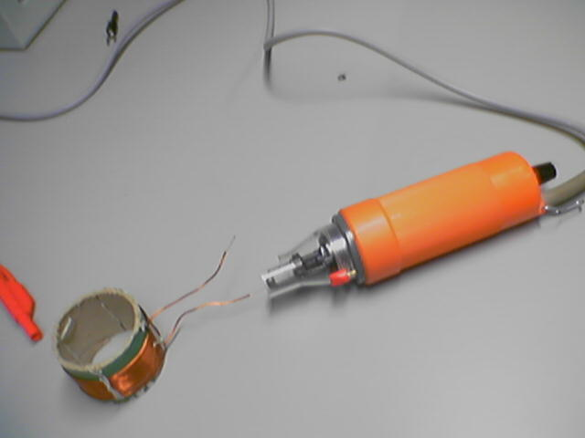
Remove the insulating varnish

Slide 19
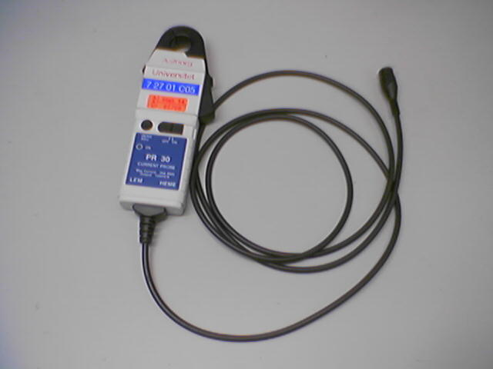
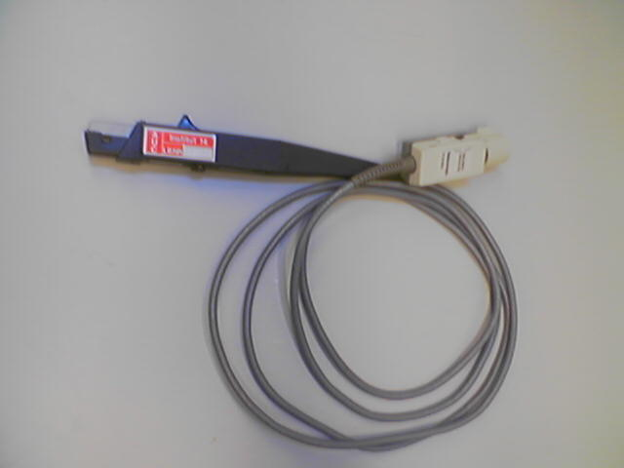
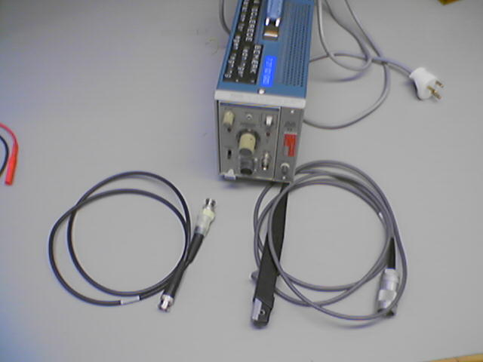
Current measurement

Slide 20
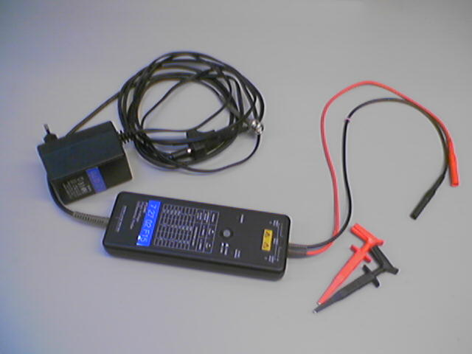
Voltage measurement

Slide 21
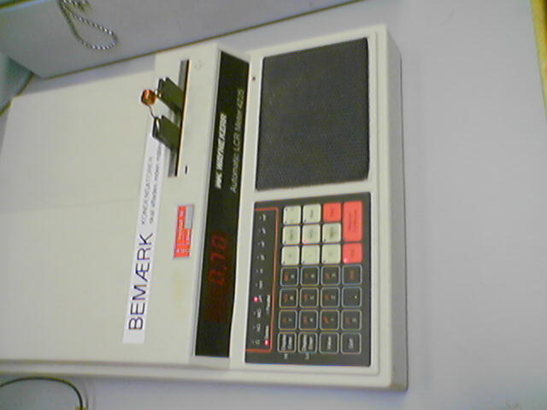
LCR meter

Slide 22
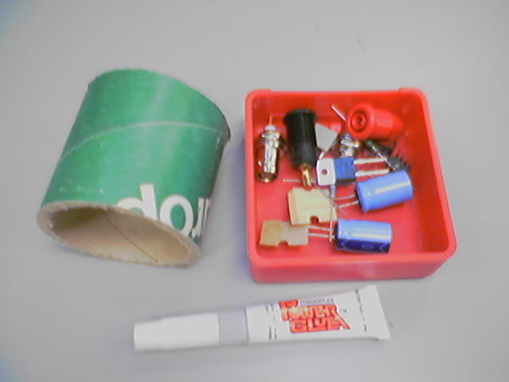
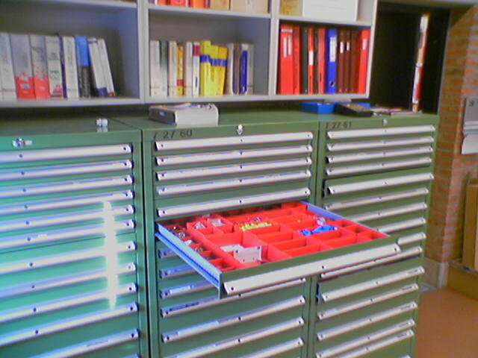
Components

Slide 23
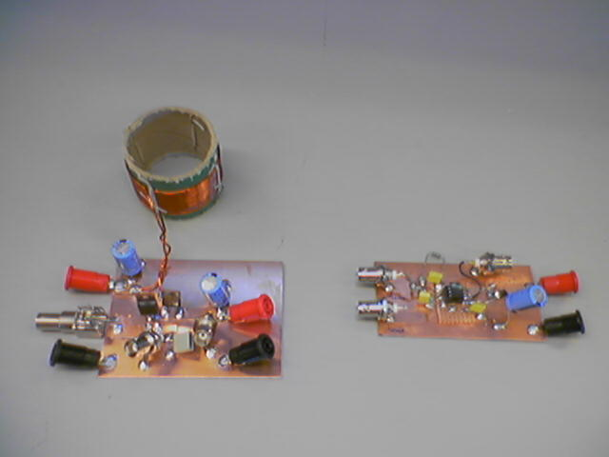
Boost and Current Mode control (uc3843)

Slide 24
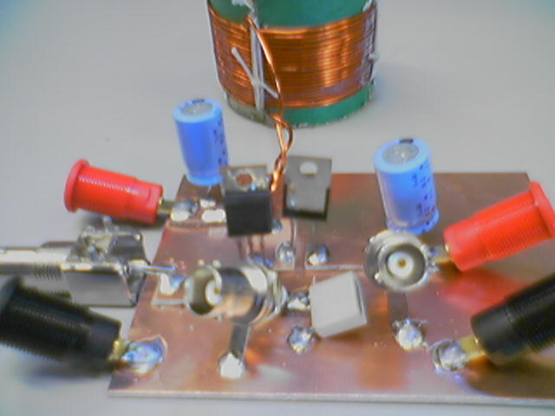
Boost converter – rapid prototyping

Slide 25
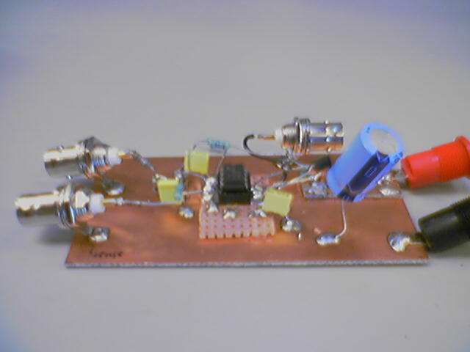
PWM controller - rapid prototyping

Slide 26
Measurement: Continuous Conduction mode (CCM)
Output voltage
Gate voltage
Inductor current

Slide 27
Measurements: Discontinuous Conduction mode (DCM)
Output voltage
Gate voltage
Inductor current

Slide 28
Measurements: Load step (short circuit on output)
Output voltage
Gate voltage
Inductor current

Slide 29
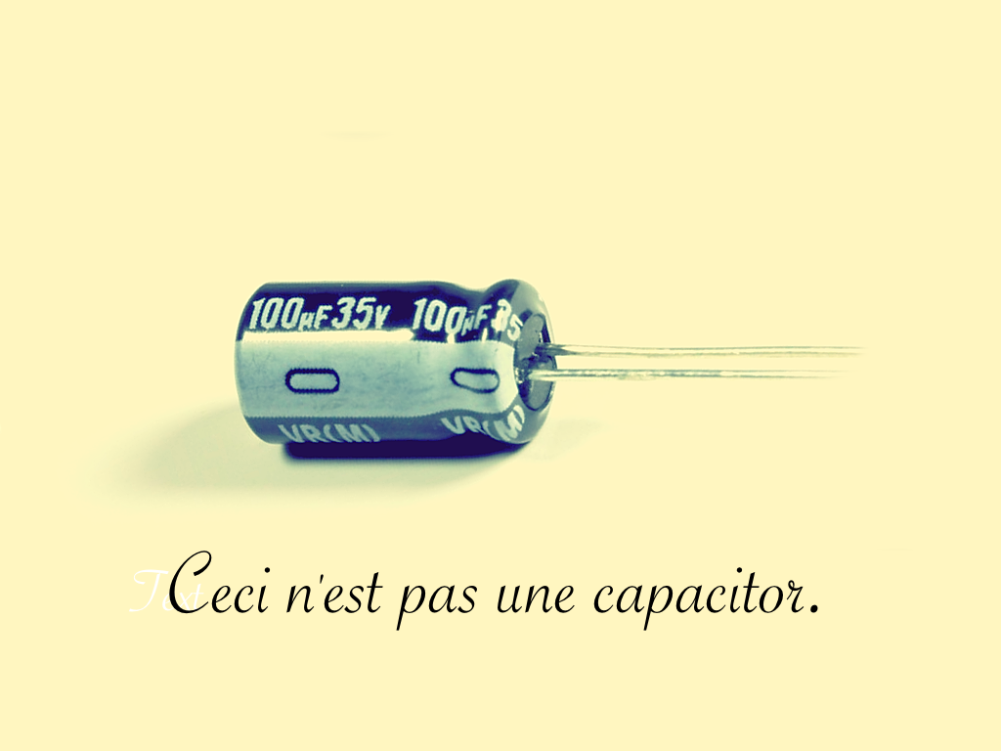
Exercise
Each group characterizes one capacitor and one inductor
Send
1: electrical circuit model (Inductor: L,ESR
Capacitor: C, ESR, ESL)
2: measured model parameters
3: plot of impedance Z=f(Hz): include amplitude and angle plot as function of frequency on a logarithmic scale.
4: picture of inductor and capacitor
5: picture of measurement setup
6: type of instruments used
to
smn@et.aau.dk

